Slide 1
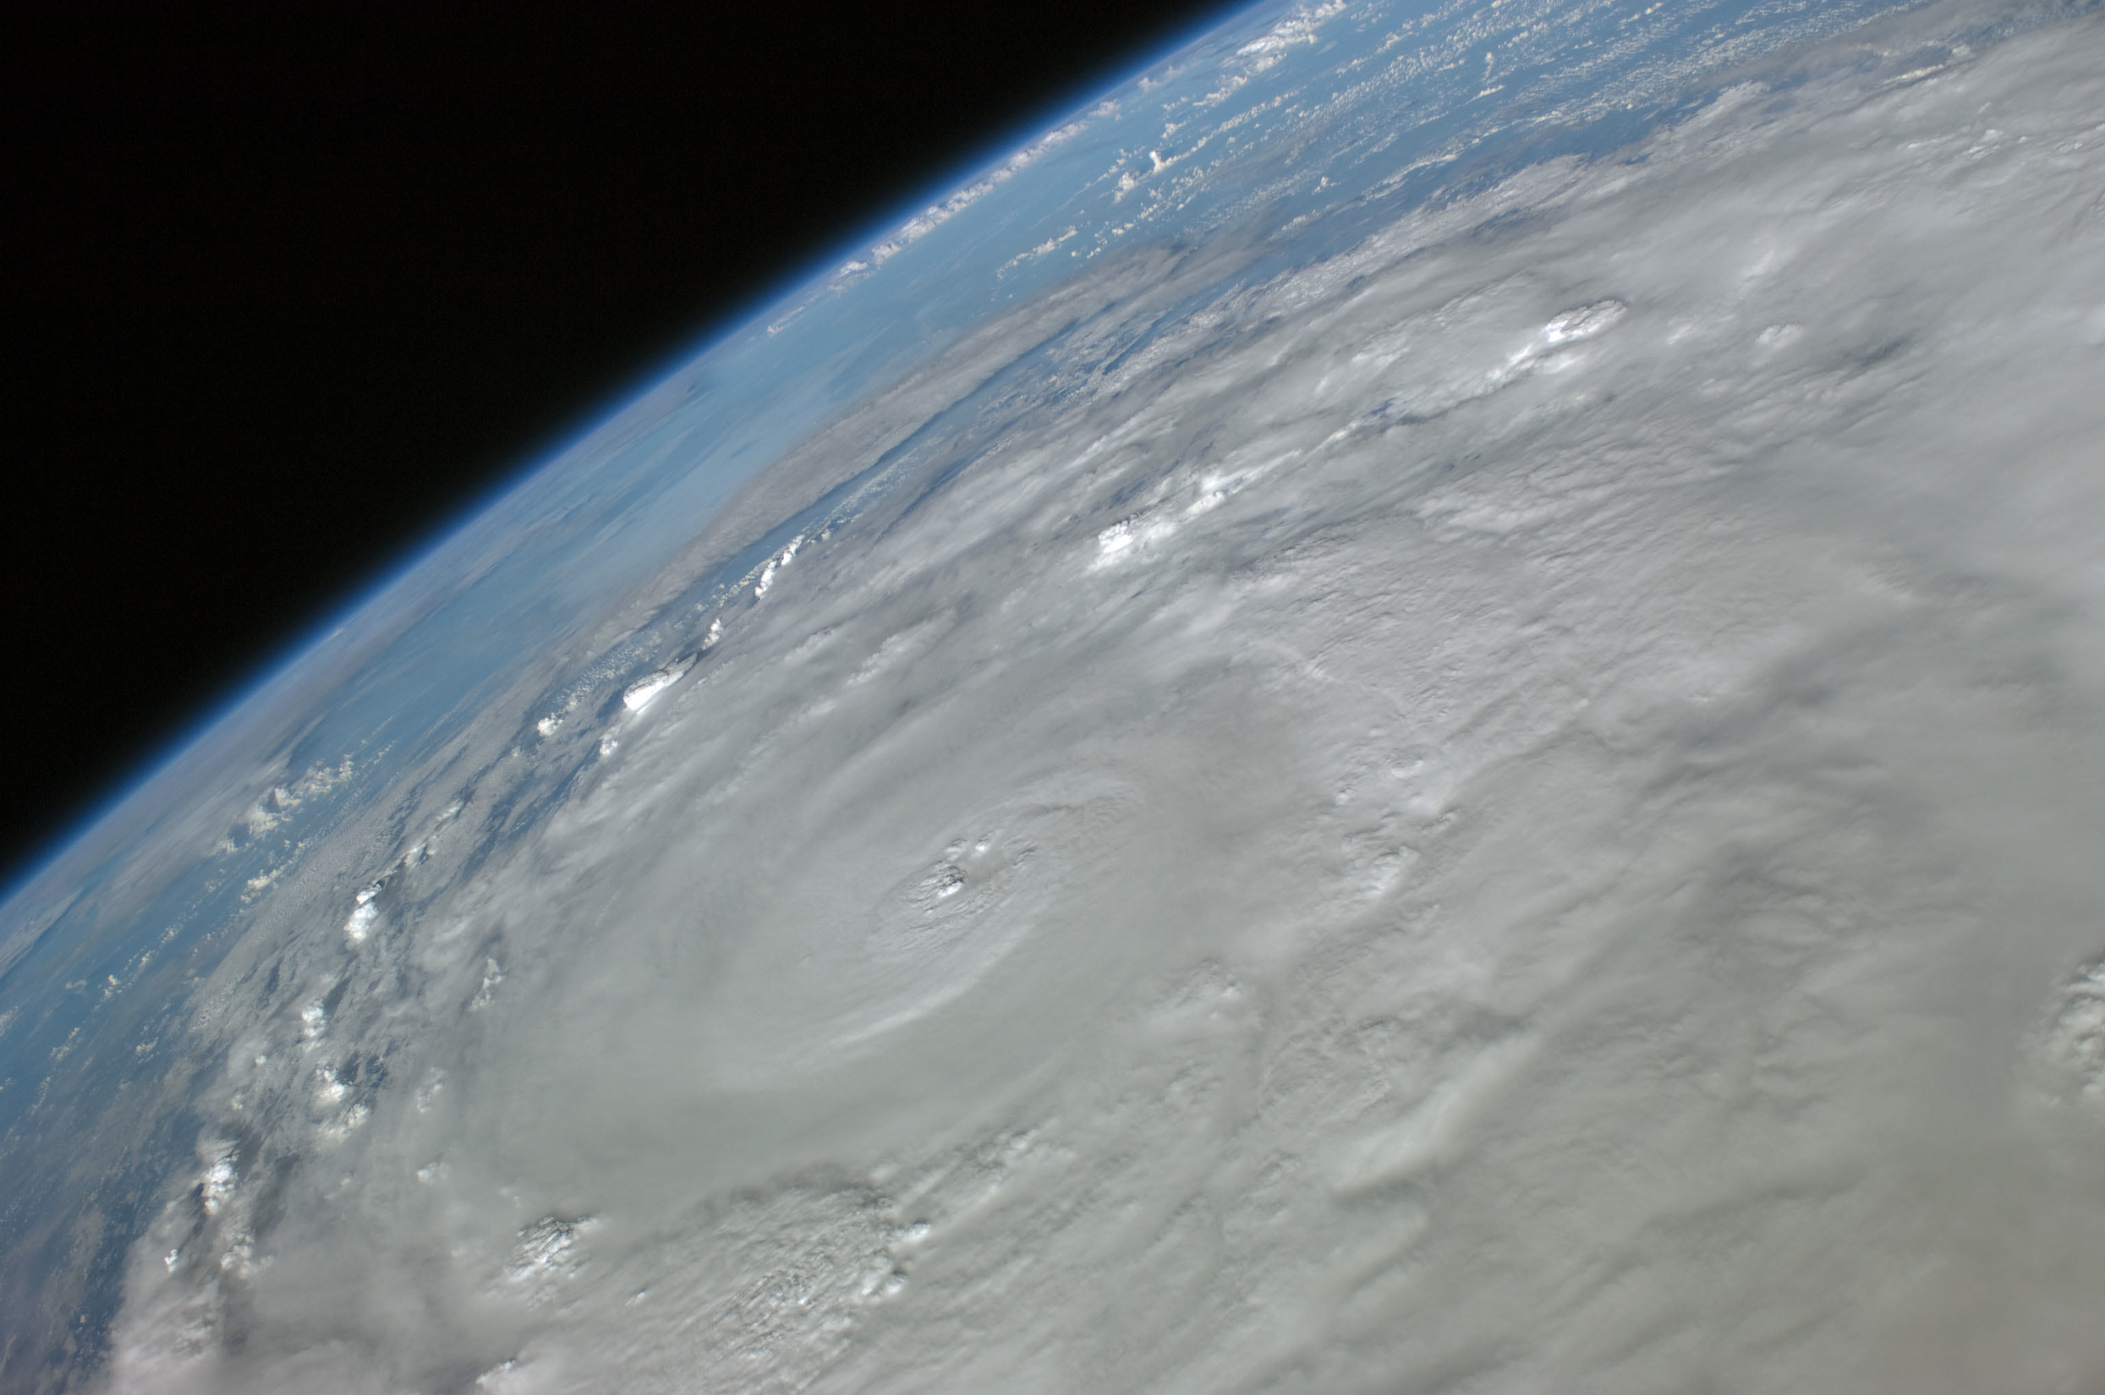



Developing a high-resolution coupled regional climate model for the tropical Atlantic region
Raffaele Montuoro
Supercomputing Facility, Texas A&M University
Ping Chang, R. Saravanan
Depts. of Oceanography & Atmospheric Sciences, Texas A&M University
L. Ruby Leung
Pacific Northwest National Laboratory
UCAR SEA Conference 2012, Boulder, CO – February 22, 2012

Slide 2
A Coupled Regional Climate Model (CRCM)
Extreme climate events affecting the US—hurricanes, severe precipitation, drought—are influenced by the conditions in the tropical Atlantic region
Ability to simulate accurately the climate mean and variability in the tropical Atlantic becomes crucial
Results from current climate models show biases in the tropical Atlantic climate. Too coarse resolutions unable to resolve some of the processes responsible for such biases.
A high-resolution coupled climate model may be effective in addressing the tropical bias. Grid resolution as low as 1km.

Slide 3
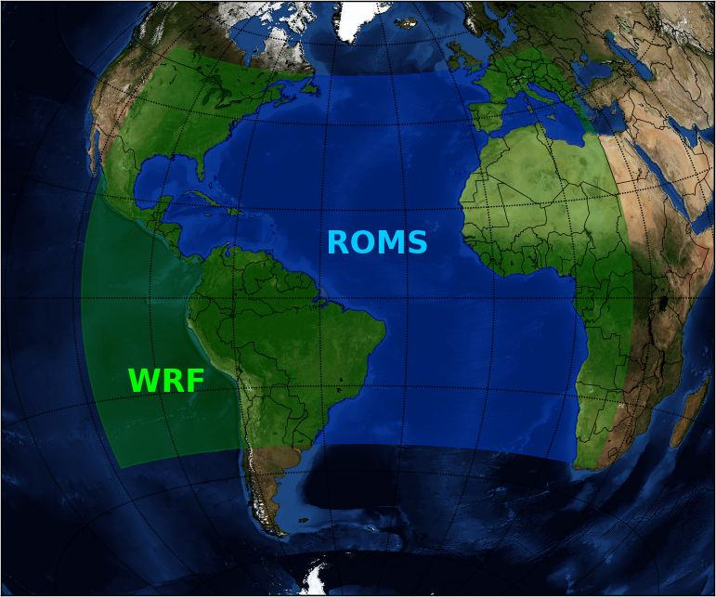
Ocean/Atmosphere domains in CRCM

Slide 4
Mechanics of ocean/atmosphere coupling
Defining exchange process and quantities

Slide 5
The coupling process
Coupling time?
Yes
Collect & Write SST
No
Time step:
k = k + 1
Atmosphere
Read near surface fluxes
Ocean

Slide 6
Coupling equations: surface Reynold’s stress
velocity scale in similarity theory
Atmosphere
u and v at 10m
otherwise:

Slide 7
Coupling equations: short wave & heat flux
net short wave flux at ground surface
heat flux at ground surface
latent heat flux at the surface
upward heat flux at the surface
surface emissivity
Atmosphere
downward long wave flux at ground surface
sea surface temperature

Slide 8
Coupling equations: water balance
accumulated total cumulus precipitation at time step k
accumulated total grid scale precipitation at time step k
Atmosphere
model time at time step k
upward moisture flux at the surface

Slide 9
Implementation overview
WRF/ROMS coupled code

Slide 10
Critical steps in model coupling
Simultaneous execution of parallel (MPI) independent codes

Slide 11
Critical steps in model coupling
Simultaneous execution of parallel (MPI) independent codes
Data exchange between models—several different ways possible. I/O Interfaces.

Slide 12
Critical steps in model coupling
Simultaneous execution of parallel (MPI) independent codes
Data exchange between models—several different ways possible. I/O Interfaces.
Synchronization
Intra-model – pre/post coupling data input/output
Inter-model – sync time loops, exchange data at right time
BARRIER
BARRIER
BARRIER
BARRIER

Slide 13
Implementation strategies
Minimal modifications to original model codes to improve portability
Modularity: enclose coupling code into software modules
Coupling code added through preprocessor directives
Advantages:
Implementation is straightforward
Complete code after preprocessing—helps debugging
May be distributed using standard, open-source tools—e.g. GNU autoconf.
Disadvantages:
Source code may become hard to follow
No “hot” pluggable

Slide 14
The starting point …
Regional Ocean Modeling System (ROMS) version 3.4
ROMS/TOMS Framework: June 3, 2011
Snapshot:
svn: $HeadURL: https://www.myroms.org/svn/src/trunk/ROMS/Version $
svn: $LastChangedBy: arango $
svn: $LastChangedRevision: 563 $
svn: $LastChangedDate: 2011-06-03 16:26:31 -0500 (Fri, 03 Jun 2011) $
Weather Research and Forecast (WRF) Model Version 3.3.1
September 16, 2011
http://wrf-model.org/users/users.php
Only pure distributed-memory (MPI) versions used. No OpenMP/hybrid.

Slide 15
Approach to inter-model communication
Communication and data exchange between models achieved through I/O interfaces.
Software I/O interfaces of various complexity are available:
Disk I/O – generic files, NetCDF
Message Passing Interface (MPI)
Model Coupling Toolkit (MCT)
CPL7
WRF provides framework to handle generic I/O streams (default: NetCDF)
WRF’s I/O APIs allow to add custom I/O interfaces—e.g.:
external/io_coupler/
ROMS only provides a low-level interface to NetCDF calls.

Slide 16
Synchronization
Intra-model synchronization is achieved through (MPI) barriers:
Input barrier: receive -> distribute
Output barrier: collect -> send
Depending upon the I/O interface, barriers can be implicit or explicit
All WRF synchronization barriers are implicit if using I/O streams
Time loops and data exchange synchronization (inter-model) is obtained through matching timestamps for the exchanged data, waiting if no (suitable) data is available.
Use of a single (external) time loop is planned.

Slide 17
Coupled code: ROMS/WRF files
Compilers/make_macros.h
ROMS/Drivers/nl_ocean.h
ROMS/Include/cplatl.h
ROMS/Include/tamu.h
ROMS/Nonlinear/diag.F
ROMS/Nonlinear/main3d.F
ROMS/TAMU/mod_tamu_coupling.F
ROMS/Utility/inp_par.F
share/input_wrf.F
share/mediation_integrate.F
share/module_check_a_mundo.F

Slide 18
Coupled code: ROMS files
Compilers/make_macros.h
ROMS/Drivers/nl_ocean.h
ROMS/Include/tamu.h
ROMS/Nonlinear/diag.F
ROMS/Nonlinear/main3d.F
ROMS/TAMU/mod_tamu_coupling.F
ROMS/Utility/inp_par.F
Define USE_TAMU, used in makefile to include new TAMU module:
#ifdef TAMU_COUPLER
USE_TAMU := on
#else
USE_TAMU :=
#endif

Slide 19
Coupled code: ROMS files
Compilers/make_macros.h
ROMS/Drivers/nl_ocean.h
ROMS/Include/tamu.h
ROMS/Nonlinear/diag.F
ROMS/Nonlinear/main3d.F
ROMS/TAMU/mod_tamu_coupling.F
ROMS/Utility/inp_par.F
Read atmosphere (WRF) grid
Initialize coupling variables

Slide 20
Coupled code: ROMS files
Compilers/make_macros.h
ROMS/Drivers/nl_ocean.h
ROMS/Include/tamu.h
ROMS/Nonlinear/diag.F
ROMS/Nonlinear/main3d.F
ROMS/TAMU/mod_tamu_coupling.F
ROMS/Utility/inp_par.F
New option set for coupling.
Use in input:
MyAppCPP = TAMU

Slide 21
Coupled code: ROMS files
Compilers/make_macros.h
ROMS/Drivers/nl_ocean.h
ROMS/Include/tamu.h
ROMS/Nonlinear/diag.F
ROMS/Nonlinear/main3d.F
ROMS/TAMU/mod_tamu_coupling.F
ROMS/Utility/inp_par.F
Modifies diag output
– Introduces calendar date & time

Slide 22
Coupled code: ROMS files
Compilers/make_macros.h
ROMS/Drivers/nl_ocean.h
ROMS/Include/tamu.h
ROMS/Nonlinear/diag.F
ROMS/Nonlinear/main3d.F
ROMS/TAMU/mod_tamu_coupling.F
ROMS/Utility/inp_par.F
Introduce ocean to atmosphere coupling after ocean to wave:
DO ng=1,Ngrids
IF (DoTAMUCoupling(ng,iic(ng))) THEN
coupling_count = coupling_count + 1
!$OMP PARALLEL DO PRIVATE(thread,subs,tile) SHARED(ng,numthreads)
DO thread=0,numthreads-1
subs=NtileX(ng)*NtileE(ng)/numthreads
DO tile=subs*(thread+1)-1,subs*thread,-1
CALL tamu_ocn2atm_coupling()
END DO
END DO
!$OMP END PARALLEL DO
END IF
END DO

Slide 23
Coupled code: ROMS files
Compilers/make_macros.h
ROMS/Drivers/nl_ocean.h
ROMS/Include/tamu.h
ROMS/Nonlinear/diag.F
ROMS/Nonlinear/main3d.F
ROMS/TAMU/mod_tamu_coupling.F
ROMS/Utility/inp_par.F
Main module containing TAMU coupling code

Slide 24
Coupled code: ROMS files
Compilers/make_macros.h
ROMS/Drivers/nl_ocean.h
ROMS/Include/tamu.h
ROMS/Nonlinear/diag.F
ROMS/Nonlinear/main3d.F
ROMS/TAMU/mod_tamu_coupling.F
ROMS/Utility/inp_par.F
Include new input parameters for coupling

Slide 25
Coupled code: WRF files
share/input_wrf.F
share/mediation_integrate.F
share/module_check_a_mundo.F
Modifies return behavior for stream auxinput4
– No fatal error is generated when reading

Slide 26
Coupled code: WRF files
share/input_wrf.F
share/mediation_integrate.F
share/module_check_a_mundo.F
Driver for coupling – reads ROMS SSTs:
#ifdef TAMU_COUPLER
ELSE IF( ialarm .EQ. AUXINPUT4_ALARM ) THEN
IF(WRFU_AlarmIsRinging(grid%alarms(ialarm),rc=rc)) THEN
IF ( grid%coupling_import ) THEN
CALL med_read_roms_sst ( grid , config_flags )
ELSE
CALL wrf_debug(0,’ Skipping SST')
ENDIF
CALL WRFU_AlarmRingerOff(grid%alarms(ialarm),rc=rc)
ENDIF
#endif

Slide 27
Coupled code: WRF files
share/input_wrf.F
share/mediation_integrate.F
share/module_check_a_mundo.F
Checks coupling parameters in input

Slide 28
Subroutine call sequence: WRF
PROGRAM wrf
main/wrf.F

Slide 29
Subroutine call sequence: WRF
PROGRAM wrf
main/wrf.F
call wrf_run
main/module_wrf_top.F

Slide 30
Subroutine call sequence: WRF
PROGRAM wrf
main/wrf.F
call wrf_run
main/module_wrf_top.F
call integrate(grid)
frame/module_integrate.F
Driver-level recursive subroutine for integration over domains & subdomains

Slide 31
Subroutine call sequence: WRF
PROGRAM wrf
> call wrf_run
> call integrate(grid)
Check if done with domain
IF ( .NOT. domain_clockisstoptime( grid ) ) THEN
... load configuration information for grid ...
DO WHILE ( .NOT. domain_clockisstopsubtime(grid) )
CALL med_setup_step ( grid , config_flags )
... initialize nests ...
... accumulate DFI ...
CALL med_before_solve_io ( grid , config_flags )
grid_ptr => grid
DO WHILE ( ASSOCIATED( grid_ptr ) )
CALL set_current_grid_ptr( grid_ptr )
CALL solve_interface ( grid_ptr )
CALL domain_clockadvance ( grid_ptr )
CALL domain_time_test( grid_ptr, 'domain_clockadvance' )
grid_ptr => grid_ptr%sibling
END DO
CALL set_current_grid_ptr( grid )
CALL med_calc_model_time ( grid , config_flags )
CALL med_after_solve_io ( grid , config_flags )
grid_ptr => grid
... recursive: advance nests to this time level (call integrate) ...
IF (domain ending) CALL med_last_solve_io ( grid , config_flags)
END DO
END IF
Iterate forward until subtime
input/output streams
history & restart data written
Solver: advance domain by dt
Stub (compute time series)
Final history & restart output

Slide 32
Subroutine call sequence: WRF
PROGRAM wrf
main/wrf.F
call wrf_run
main/module_wrf_top.F
call integrate(grid)
frame/module_integrate.F
call med_before_solve_io( grid , config_flags )
share/mediation_integrate.F
DO ialarm = first_auxhist, last_auxhist
... write history data ...
END DO
DO ialarm = first_auxinput, last_auxinput
...
#ifdef TAMU_COUPLER
! - Get ROMS SST
ELSE IF( ialarm .EQ. AUXINPUT4_ALARM ) THEN
IF( WRFU_AlarmIsRinging( grid%alarms( ialarm ), rc=rc ) ) THEN
IF ( grid%coupling_import ) THEN
CALL med_read_roms_sst ( grid , config_flags )
ELSE
CALL wrf_debug(0,' Skipping SSTs')
ENDIF
CALL WRFU_AlarmRingerOff( grid%alarms( ialarm ), rc=rc )
ENDIF
#endif
ELSE IF ( ... ) THEN
...
END DO
... write restart data ...
... look for boundary data ...
Input SSTs

Slide 33
Subroutine call sequence: WRF
PROGRAM wrf
main/wrf.F
call wrf_run
main/module_wrf_top.F
call integrate(grid)
frame/module_integrate.F
call med_before_solve_io( grid , config_flags )
share/mediation_integrate.F
DO ialarm = first_auxhist, last_auxhist
... write history data ...
END DO
DO ialarm = first_auxinput, last_auxinput
...
#ifdef TAMU_COUPLER
! - Get ROMS SST
ELSE IF( ialarm .EQ. AUXINPUT4_ALARM ) THEN
IF( WRFU_AlarmIsRinging( grid%alarms( ialarm ), rc=rc ) ) THEN
IF ( grid%coupling_import ) THEN
CALL med_read_roms_sst ( grid , config_flags )
ELSE
CALL wrf_debug(0,' Skipping SSTs')
ENDIF
CALL WRFU_AlarmRingerOff( grid%alarms( ialarm ), rc=rc )
ENDIF
#endif
ELSE IF ( ... ) THEN
...
END DO
... write restart data ...
... look for boundary data ...
Output surface fluxes data
Input SSTs

Slide 34
Input: ROMS
MyAppCPP = TAMU
TAMU_start_year = 1981
TAMU_start_month = 05
TAMU_start_day = 01
TAMU_start_hour = 00
TAMU_start_minute = 00
TAMU_start_second = 00
TAMU_coupling_interval = 60
TAMU_coupling_delay = 0
TAMU_coupling_import = T
TAMU_coupling_export = T
TAMU_grid_input = wrfinput_d01
TAMU_input = cpl_flx.nc
TAMU_output = cpl_sst.nc

Slide 35
Input: WRF
&time_control
...
io_form_auxinput4 = 2
io_form_auxhist5 = 2
auxinput4_inname = "cpl_sst.nc"
auxhist5_outname = "cpl_flx.nc"
/
&roms_coupling
coupling_interval = 60,
coupling_import = .true.,
coupling_export = .true.,
import_max_attempts = 100,
/

Slide 36
Results
CRCM hurricane simulations

Slide 37
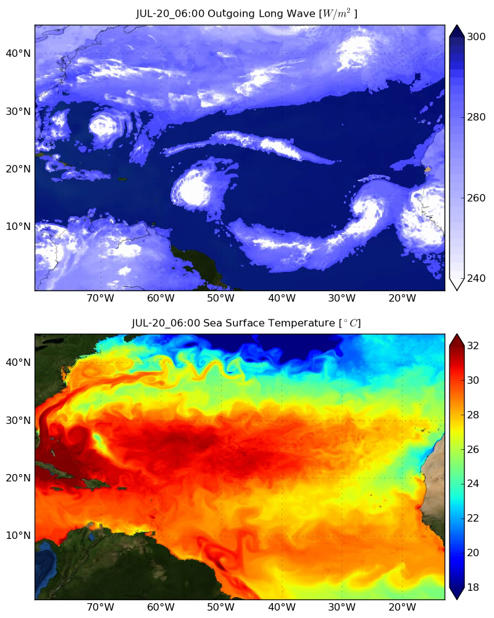
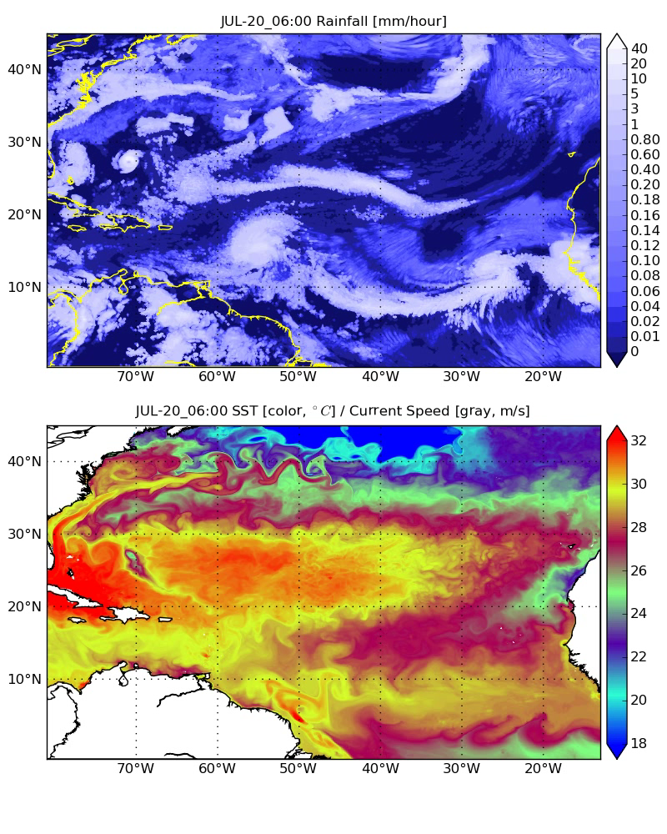
Ocean/Atmosphere interaction along the path of a hurricane at 9km resolution

Slide 38
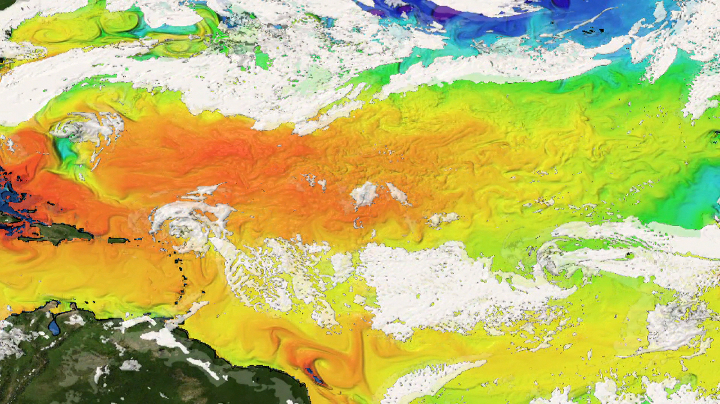
Ocean/Atmosphere interaction during hurricane season (9km)

Slide 39
Thank you!
UCAR SEA Conference 2012

